Slide 1

ROCKBUSTER STEALTH LLC by Sonal

Slide 2
PROJECT OVERVIEW
Rockbuster Stealth LLC i s a movie rental company that used to have stores around the
world. Facing stiff competition from streaming services such as Netflix and Amazon Prime,
the Rockbuster Stealth management team is planning to use its existing movie licenses to
launch an online video rental service i n order to stay competitive.
OVERVIEW
This presentation aims to leverage data analytics to answer critical business questions that will inform Rockbuster’s strategy for 2020 as they transition to an online service model. These insights will guide decision-making processes and strategic planning.

Slide 3

KEY QUESTIONS
Which movie contributed the most/least to our revenue?
What was the average rental duration for all videos?
Which countries are Rockbuster customers based in?
Where are customers with a high lifetime value based?
Do sales figures vary between geographic regions?

Slide 4
SUMMARY STATISTICS
Total Revenue
61312
Total customers-599
Total countries-109
Average Rental Rate-3
Average Rental Duration -5 days
Most common movie rating-PG-13

Slide 5
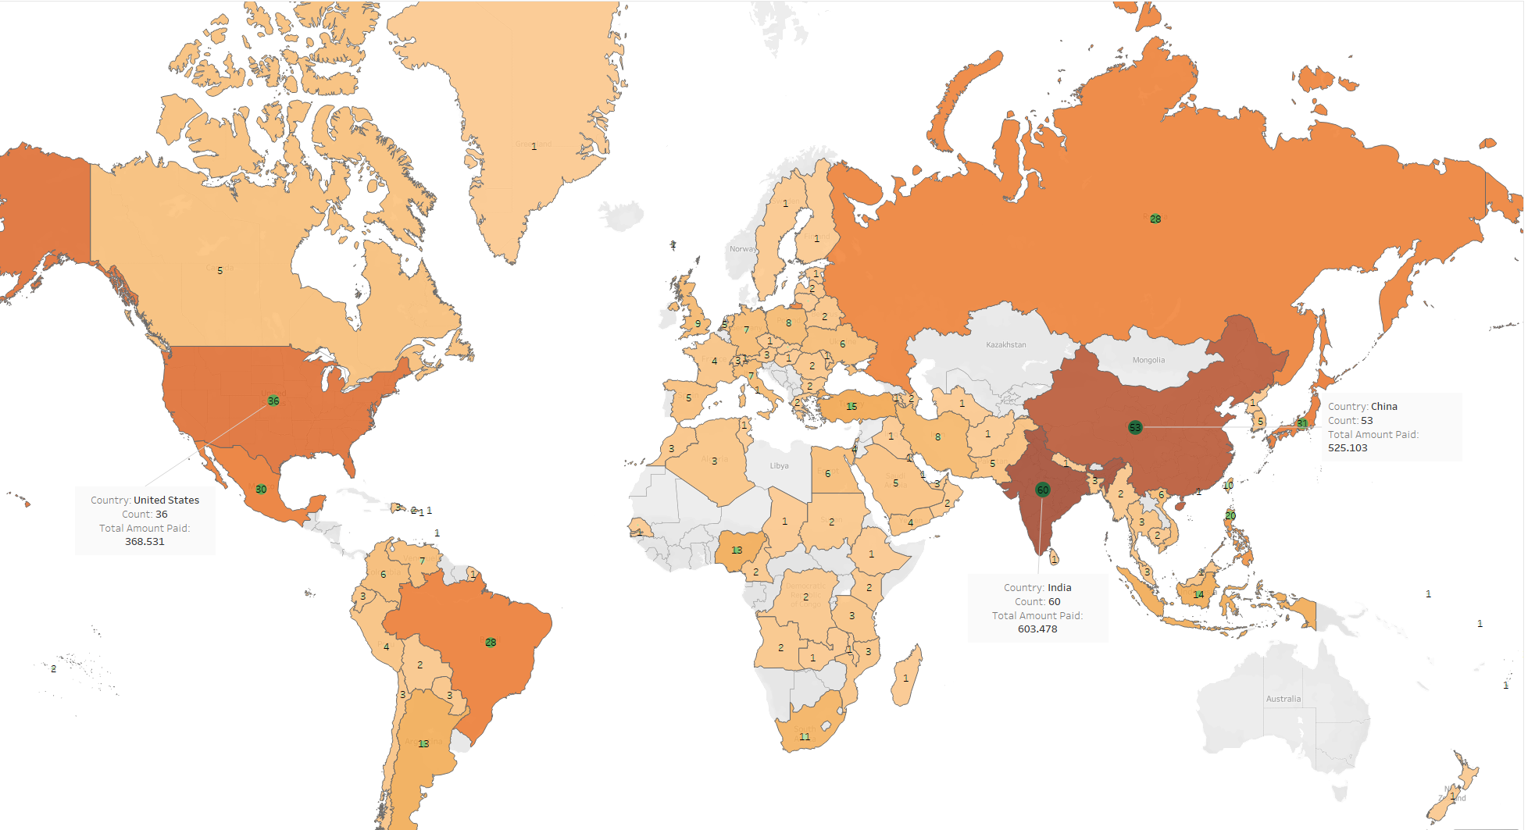
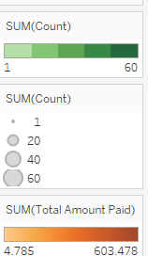
WHICH COUNTRIES ARE ROCKBUSTER CUSTOMERS BASED IN?
Top 3 Countries
India
China
United States

Slide 6
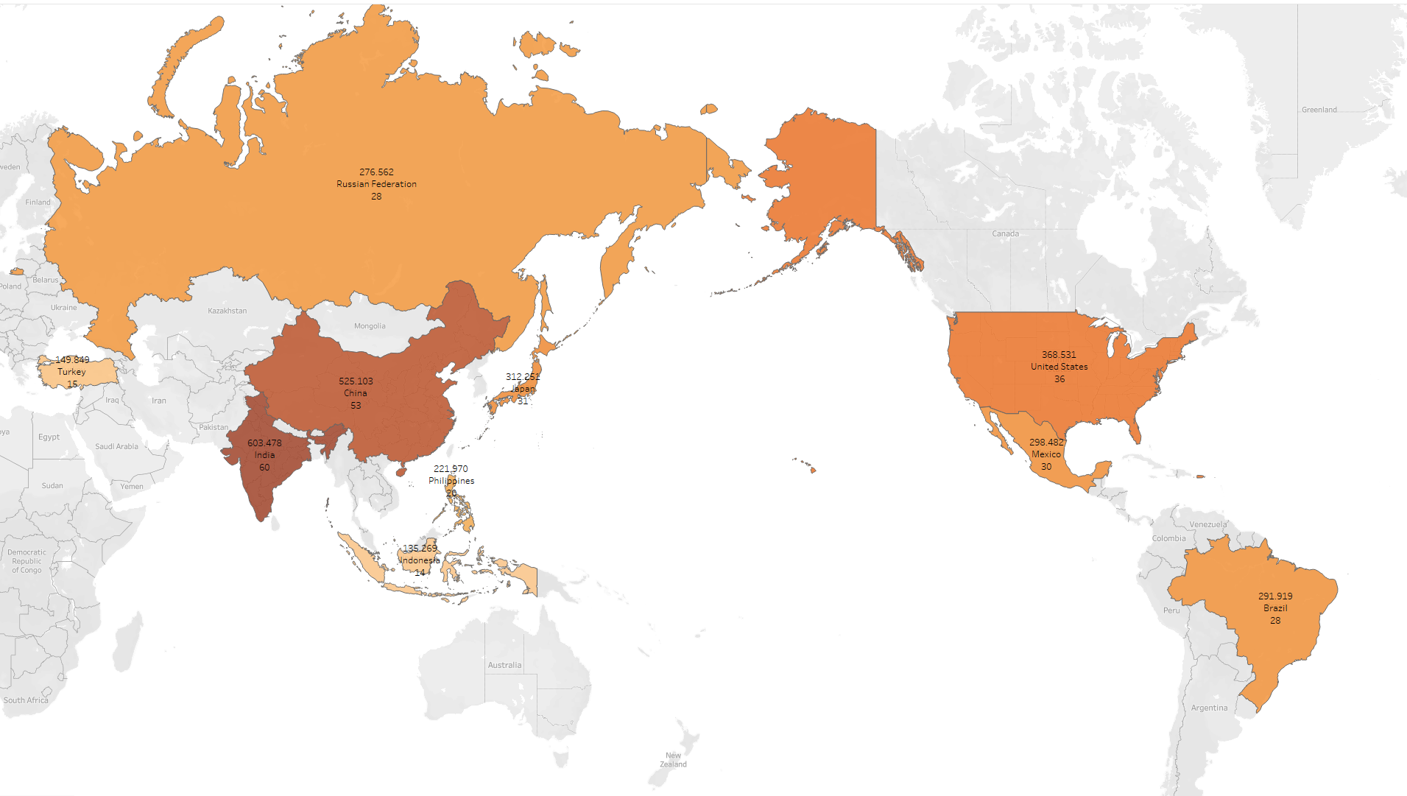
DO SALES FIGURES VARYN BETWEEN GEOGRAPHICAL REGIONS?
Higher sales correlate with larger customer bases. India has the highest customer count and highest revenue generation as well. China, United States, Japan & Mexico follows the lead.

Slide 7
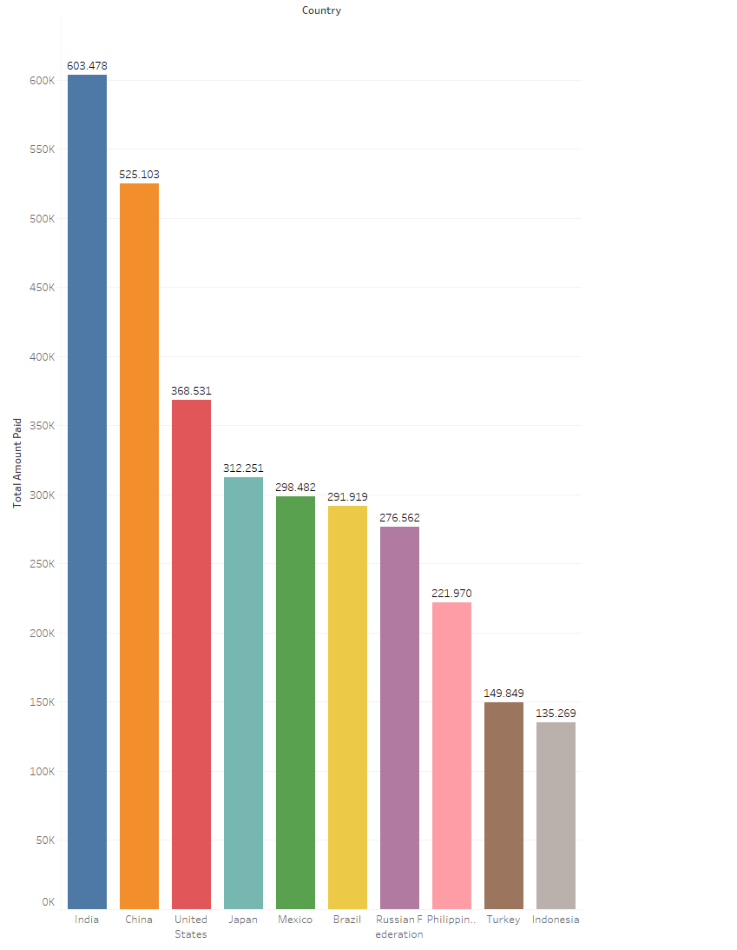
WHERE ARE CUSTOMERS WITH A HIGH LIFETIME VALUE BASED?
Top 10 customers are within the top 10 countries with highest revenue.
Identifying where high lifetime value customers are based enables Rockbuster to strategically focus its resources and customer service efforts to retain and further engage these valuable clients.

Slide 8
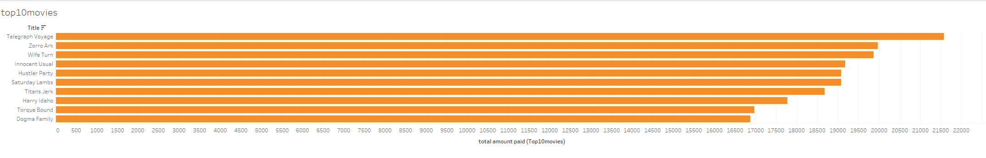
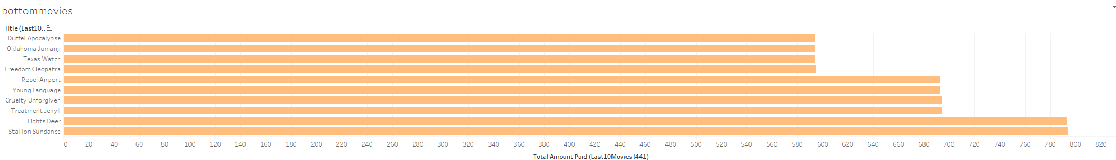
WHICH MOVIE CONTRIBUTED THE MOST/LEAST TO OUR REVENUE?

Slide 9
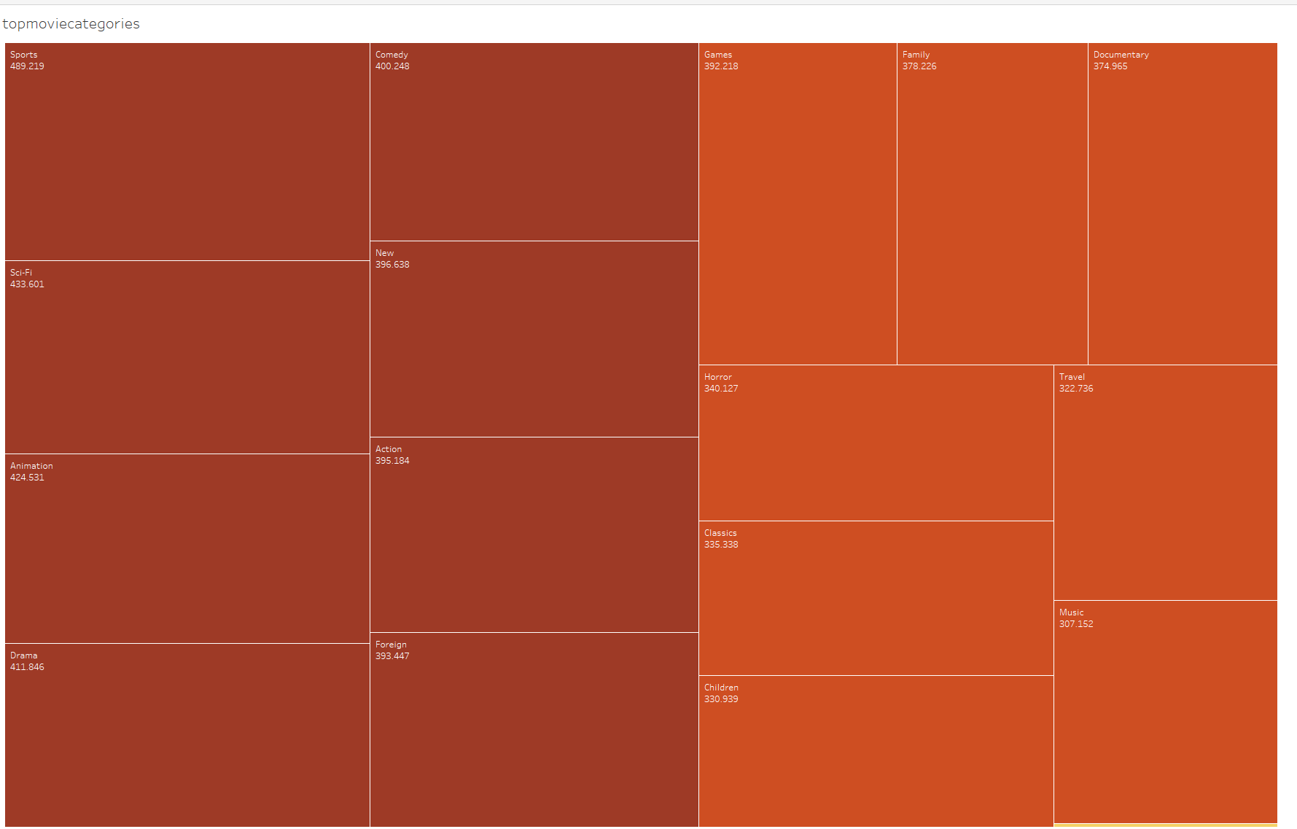
MOST POPULAR GENRES
Top movies are from Sports, Sci-Fi, Animation, Drama and Comedy Genres.

Slide 10
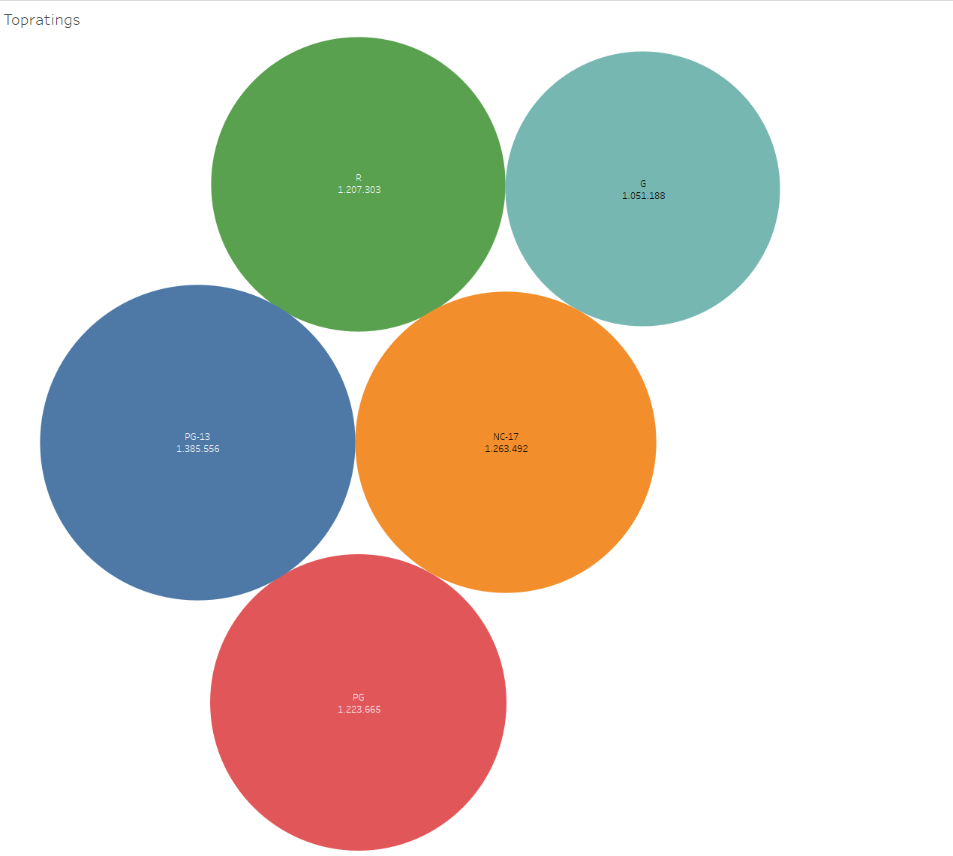
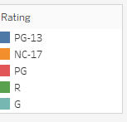
MOST POPULAR RATINGS
PG-13 rated films generated the most amount of revenue

Slide 11

MOVIES GREATER THAN AVERAGE RENTAL DURATION
All film rental durations lasted between 3 – 7 days • The most frequent duration of rental was 6 days • The average duration of rental was 4.99 days = 5 days

Slide 12
CONCLUSION
Top movies contributing to revenue gain are Telegraph Voyage, Zorro Ark, Wife Turn, Innocent Usual, and Hustler Party.
Countries with the highest sales numbers are India, China, United States, Japan, and Mexico.
PG-13 rated films generated the most amount of revenue
The top genres are Sports, Sci-Fi, Animation, Drama, and Comedy.
The average duration of rental are 5 days
The majority of our high lifetime value customers are from our highest performing countries.

Slide 13
RECOMMENDATIONS
Marketing Strategy
Concentrate efforts in countries with highest customer base (India, China, US, Mexico, Japan)
Tailor marketing campaigns for key demographics in these regions
Create customized strategies/loyalty programs for high-value customers
Attract mid-tier customers with specific promotions/incentives
Product Strategy
Increase production of movies in most popular genres: Sports, Sci-Fi, Animation
Feature new releases and movies from last 10 years
Offer movies of various lengths, focusing on average rented length (115 mins)
Customer Retention & Loyalty
Develop rewards program to encourage loyalty and high lifetime value
Advertise availability of most popular movies.
By implementing these strategies, RockBusted can effectively target high-value customers, cater to popular movie preferences, and foster customer loyalty, ultimately driving increased revenue and success.

Slide 14



QUESTIONS
Contact- sonal2013.jain@gmail.com
Tableau Link- https://public.tableau.com/authoring/Rockbustermovierentalanalysis/chloro#1

